Slide 1

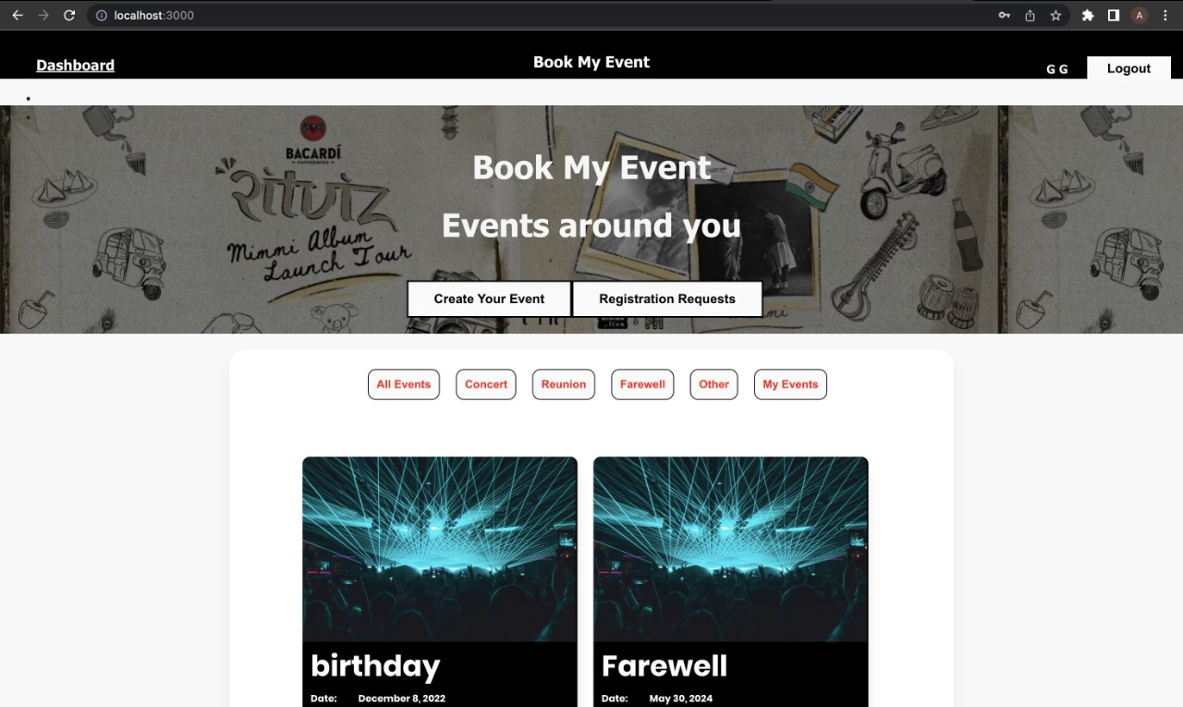
Book
My
Event
Your Go-To Website To Register And Create Events.
Pratiksha Patil:- 002762706
Gayatri Dalvi:- 002711803
Aniket Bhore:- 002756183
Neha Shende:- 002783740

Slide 2
Background:
Tired of standing in long lines to book your favorite event? Don't worry! Book My Event is here to book your beloved event at the comfort of your house. While there are hundreds of events happening in your city, visiting ticket counter of all your favorite events is a tedious task, add to the act that popular shows get sold out even before you reach there.
With Book My Event, User can register for an event and check the availability even before the event starts.
Users can also Host events for their friends and family and can also send Invitees.
Users can Sign Up, Login, and see all the available events, book events, see past events, as well as organize events, update and delete events, lastly users and also accept and reject the potential invitees.

Slide 3
Benefits:
Enhanced Customer Support
Customizable
Increases Speed of Sales process
Friendly UI
User can Sign Up and Create his/her profile.
They can choose to host or attend an event
They can create event and accept or reject attendees
Host can update and/or delete an event

Slide 4
Contributions:-
Pratiksha Patil:- Dashboard Page, Designed UI for dashboard and footer,Code documentation,Bcrypt for password hashing ,dashboard, approval,Rejection controller design,schema ,added filter to dashboard ,design for user,Designed backend for registration request,Mongodb,end to end Testing
Gayatri Dalvi:- Create Event Page,Designed UI for Create Event,Code documentation,Event Controller design,schema design for event and controller design user,designed backend and UI for delete event,Mongodb,end to end Testing,Designed Ui for registration Request ,validation for create event page.
Aniket Bhore:- Login Page, Validation to Login , Designed UI for Login and Changes in UI of Dashboard, Design UI for View Guest. ,Login Controller design,designed schema for registration,DB connection ,Mongodb,end to end Testing,UI for view ticket,code documentation,bug and layout fixing.
Neha Shende:- Sign Up page, Validation for signup page, JWT Tokenization for session management and authorization,Designed UI for Sign Up Page, Design UI for Navbar ,code documentation,Registration Controller design,Mongodb connection,bug and layout fixing ,end to end Testing.

Slide 5
Features
ReactJS
Node JS Express Architecture with Cors
Mongoose to connect with MongoDB Database
MongoDB aggregation pipeline with Rest API
Easy Integration with desktop and mobiles
User Login and User Sign Up
Used bcrypt for password hashing
JWT tokens for user authentication and session management.

Slide 6
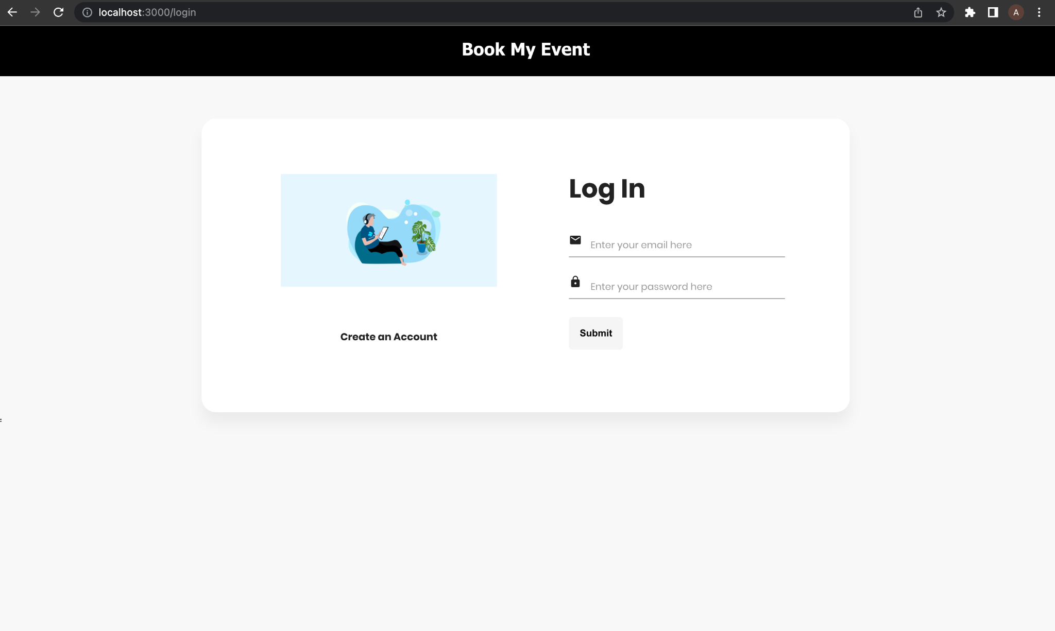
Login Page:

Slide 7
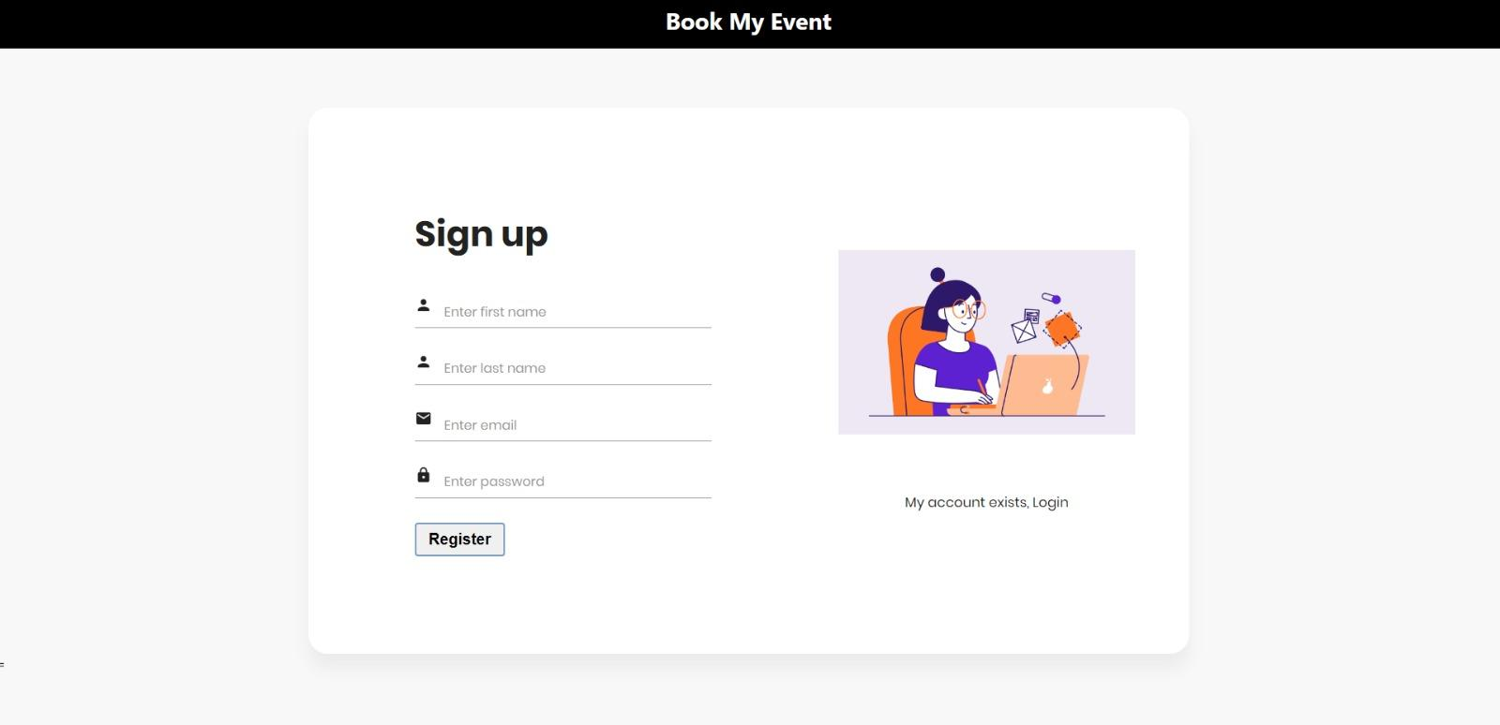
Sign Up Page:

Slide 8
DashBoard:-

Slide 9
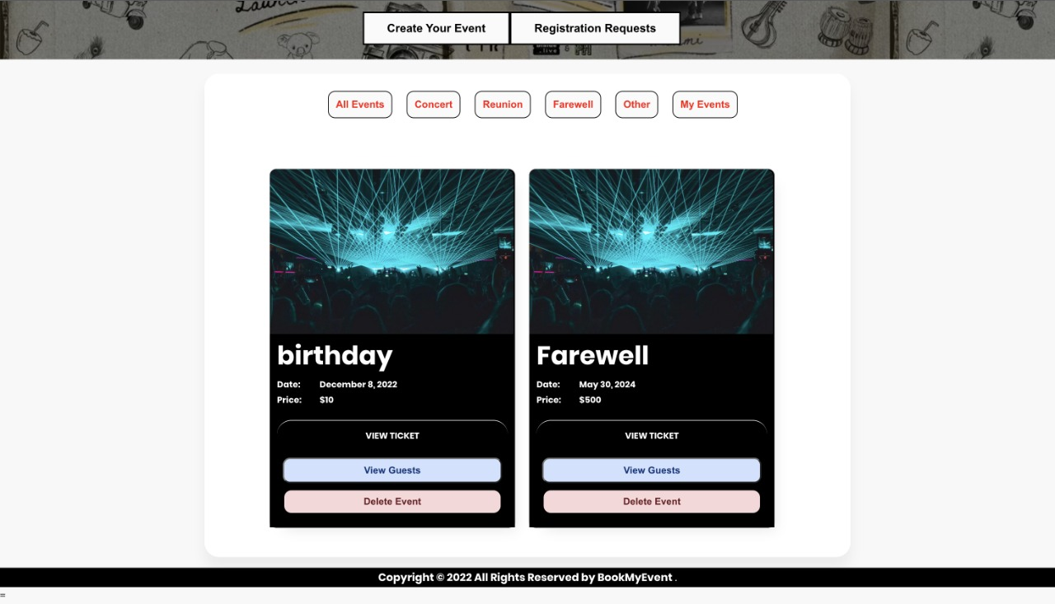

Slide 10
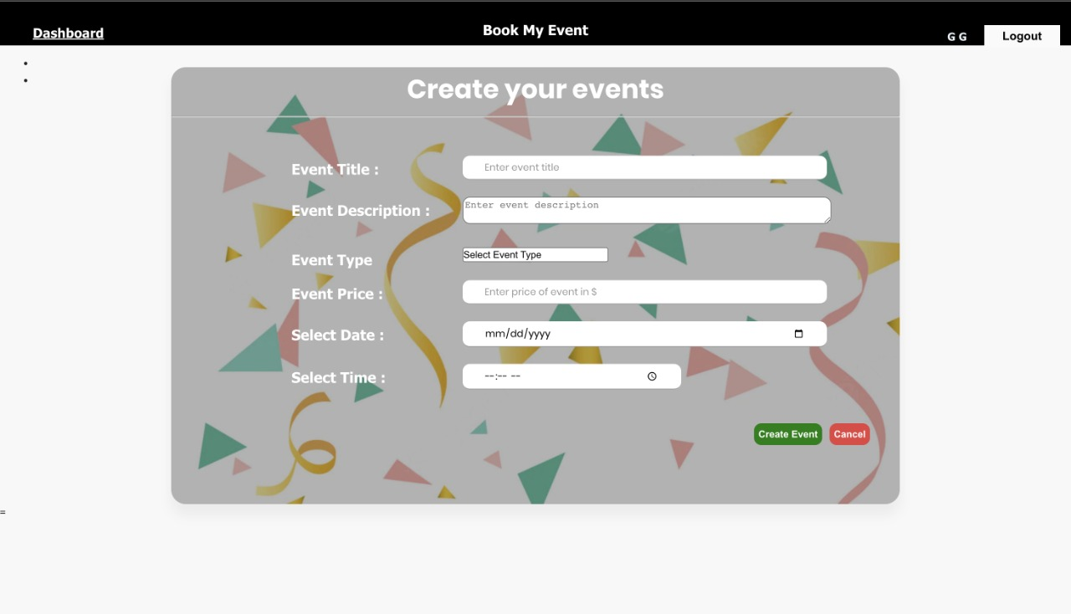
Create Event:

Slide 11
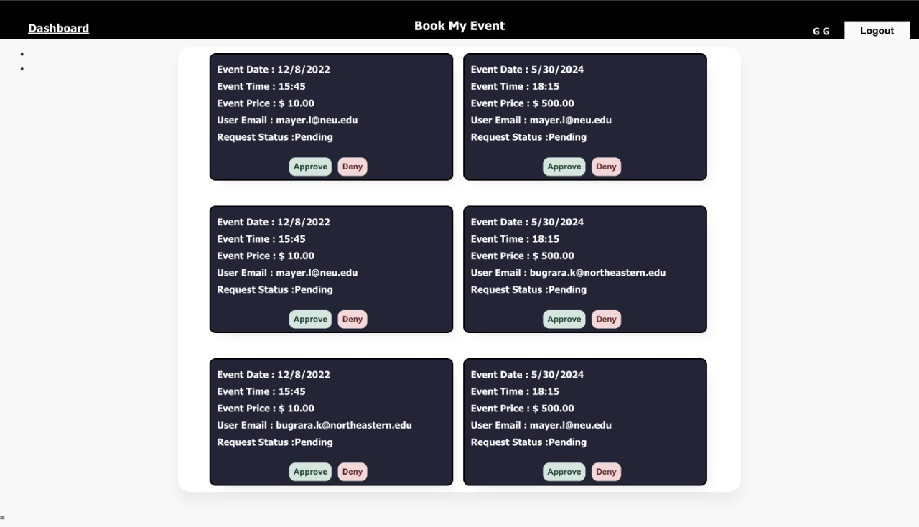
Registration Request:

Slide 12
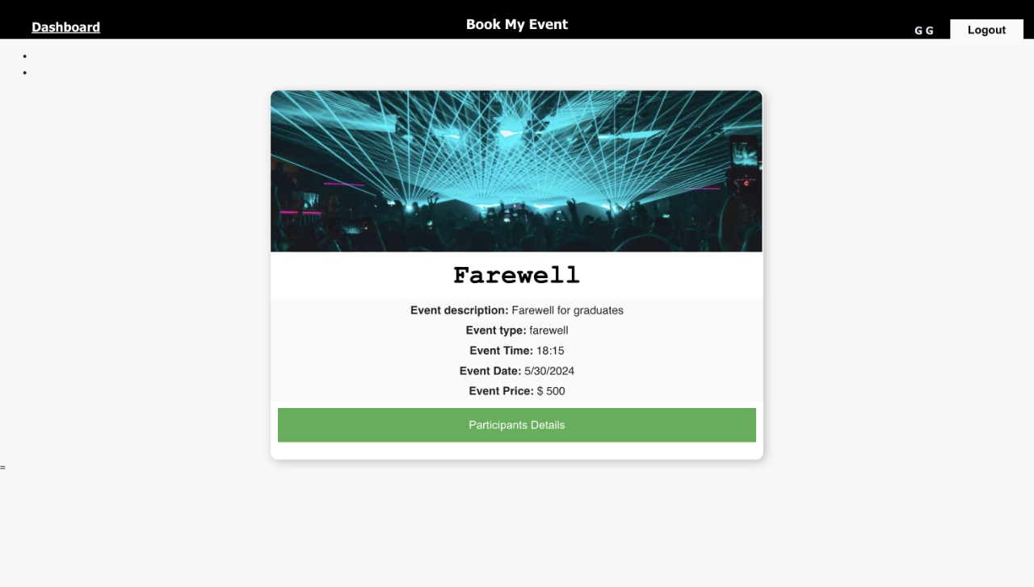
View Ticket

Slide 13
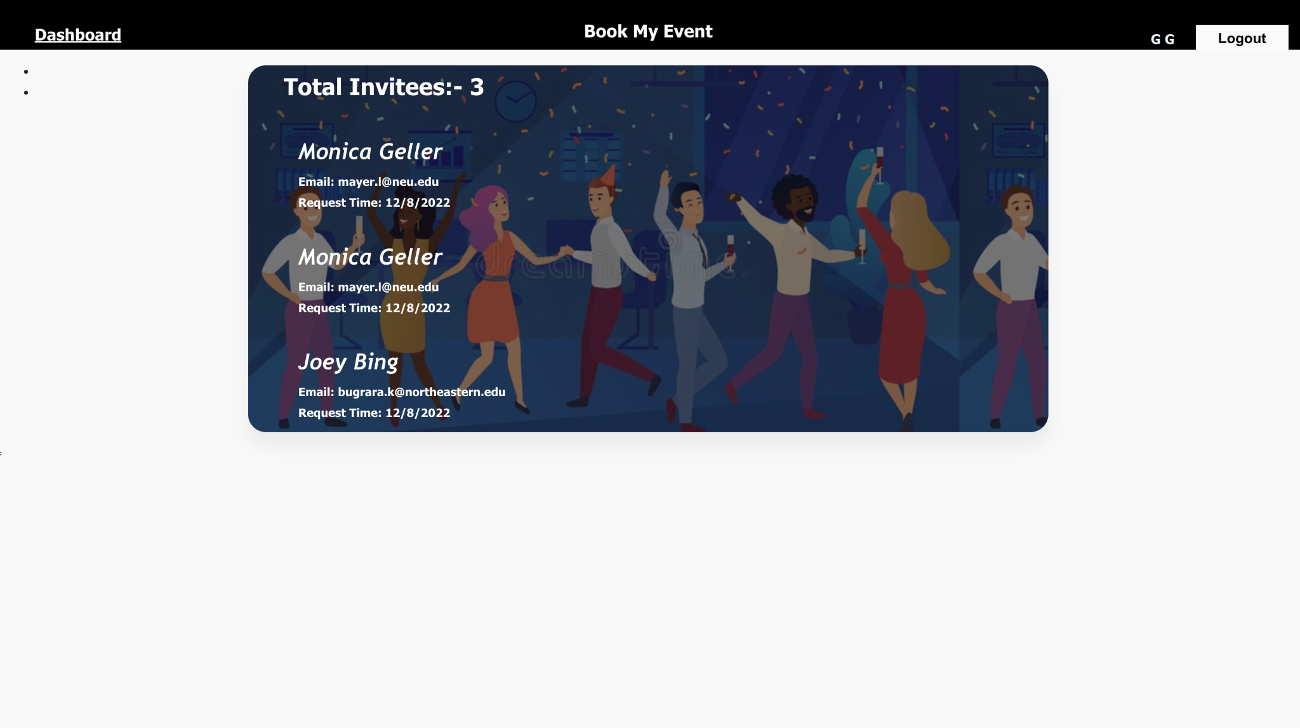
View Guest:-

Slide 14
Thank You!!!

